Slide 1


Ayakshm: HealthCare Management System
Guided by: Mr. Prathamesh Naik Presented by: Group 10
Ajay Bhosle 220943020002
Atharv Suryavanshi 220943020009
Gaurav Urkude 220943020027
Saurabh Potdukhe 220943020082

Slide 2


Agenda
Introduction
Technologies and Software Used
Problem Statement
System Architecture
Types of User Involved
Main Featured of Patient
Main Featured of Doctor
Main Featured of Hospital
Main Featured of Admin
Future scope
Conclusion

Slide 3



Introduction
Health-Care Management System application provides a online platform for Patients to registered and find Hospitals, Doctors as well as Treatments under hospitals.
Patients can access detailed information about Hospitals and Treatments and can compare different Doctors to find suitable one.
Hospitals and Doctors also registered to the portal so that they can be able to connect with more Patients who have matching medical requirements.

Slide 4






Technologies and Software used

Slide 5
Problem Statement
We have experienced worst phase of this decade during the COVID-19 pandemic, so many lives were lost because of the lack of co-ordination between hospitals and patients.
From patients’ perspective, it is hard for them to find hospitals, doctors, treatments and to compare between them, Also carrying all the medical records in hard copy related to a treatment is difficult.
For doctors, it is hard to treat the patient if they don’t know the medical history of that patient.
Because of these points, there is no efficient interaction between the patients, the doctors and the hospitals.

Slide 6
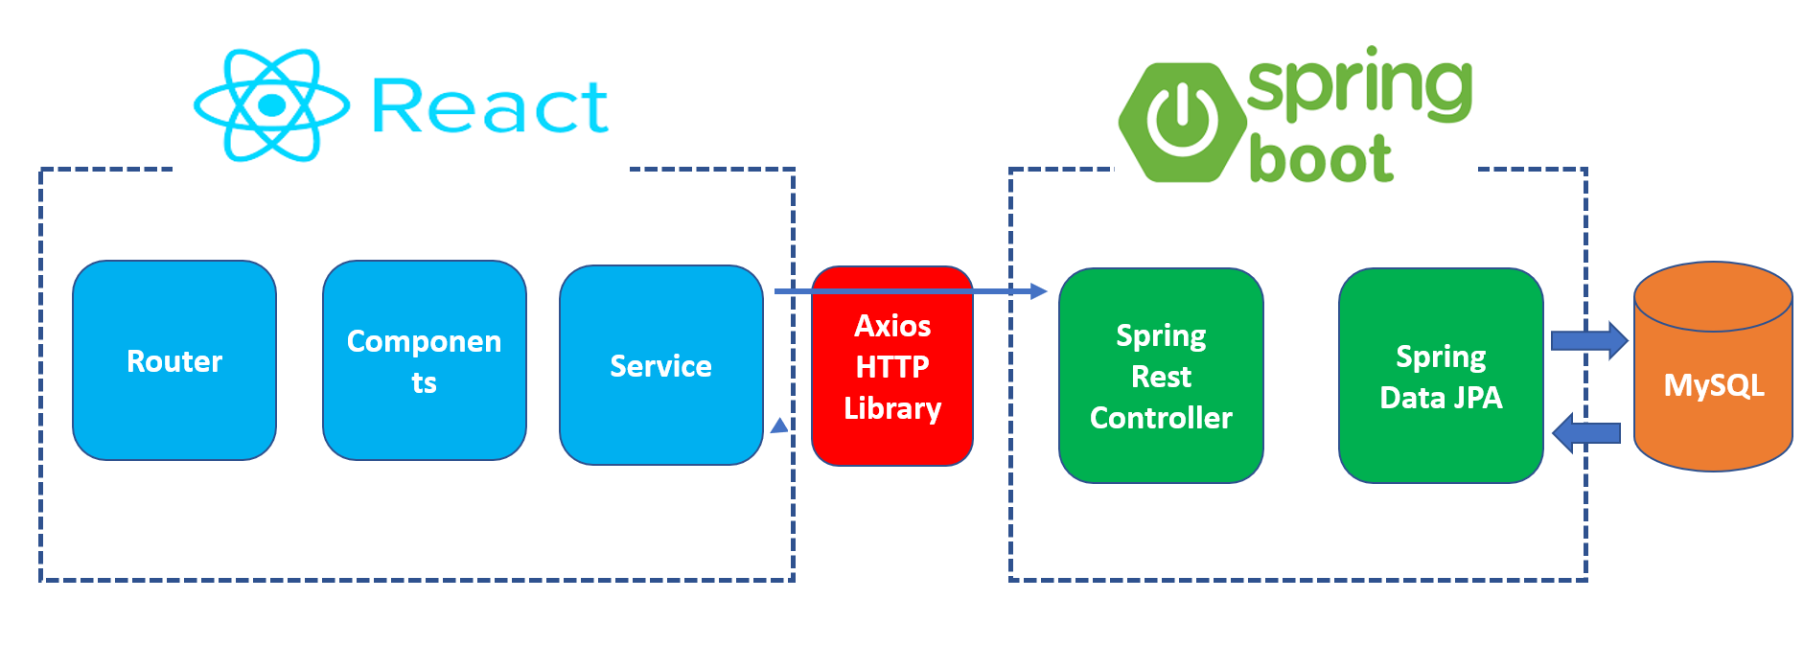
System Architecture

Slide 7




Types of users involved
PATIENT
DOCTOR
HOSPITAL
ADMIN

Slide 8
Main Features of patient
Patient can register and create his own account.
Healthcare Management System provides the function which allows Patient to browse treatments.
Patient can browse hospitals and see their information as well as the doctors and the treatments available in the hospital.
Patient can also browse medical services.

Slide 9
Main Features of Doctor
Doctor can register and create their own account individually.
Doctor can see patient’s medical treatment history.
Update account option is provided to the doctor.

Slide 10
Main Features of Hospital
Hospital Administration can create its own account and maintain it.
Hospitals are able to view doctor profile.
Hospital can view all the appointments taken for the doctors, which are practicing there.
Hospital can verify a new doctor and enable / disable any doctor’s account.
Hospital is also able to delete a particular doctor’s account.

Slide 11
Main Features of Admin
Admin, like the other types of user, can register themselves into the system.
Admin can view all the hospitals attached to the system and can change their status. (enable / disable).
Admin can also verify new hospitals using the above feature.
Admin is also able to delete any hospital which is connected to the system.
Furthermore, admin can update its their profile.

Slide 12
Future scope
These features could be added to the system in the future…
The Healthcare Management System will soon be able to streamline administrative process of hospitals.
Instead of having paper files this program will use advanced technology to secure and store all patient records in one location.
Connection between doctors, medical professionals to the client or the patient will be made easy who may be at remote location.

Slide 13



Conclusion
A smart HealthCare offers a smooth experience that improves patient outcomes, increases efficient interaction and enhances eco-efficiency.
Smart Hospital will be able to provide healthcare facilities which will able to do more with less i.e. providing resources, experience and cutting-edge technologies.
Patient will effectively select through hospital, treatment and doctor as per their need.
Also the medical record of Patient will be stored in the digital format and can be accessed by the doctor while taking appointment.
This will be helpful to the doctor to view patient medical history and provide proper treatment/medical services to the patient.

Slide 14

Thank you!

